Slide 1
How to check the Equality of two arrays ?
momedaram

Slide 2
How to check the Equality of two arrays ?
Two arrays are said to be equal If
The length of both arrays is same
corresponding pairs of elements in both arrays are equal.

Slide 3
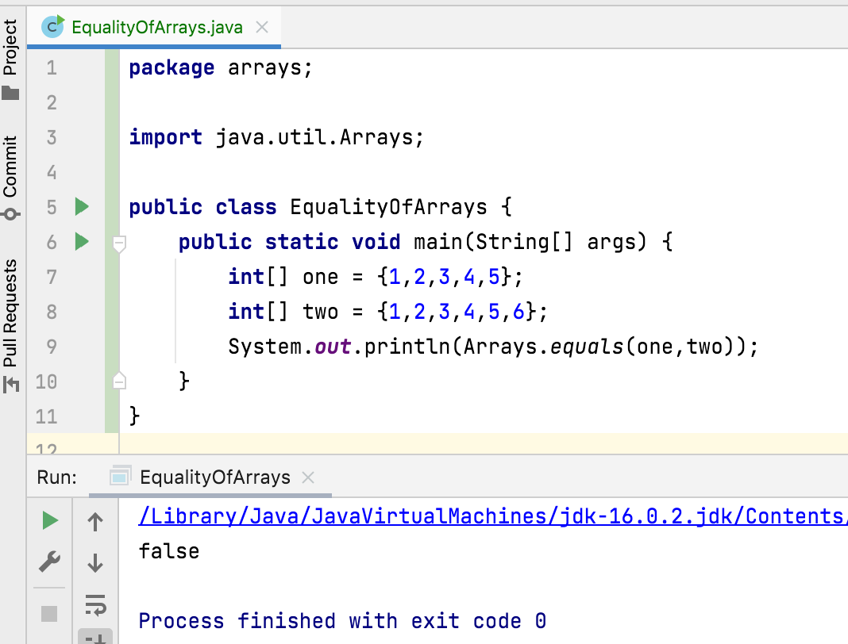
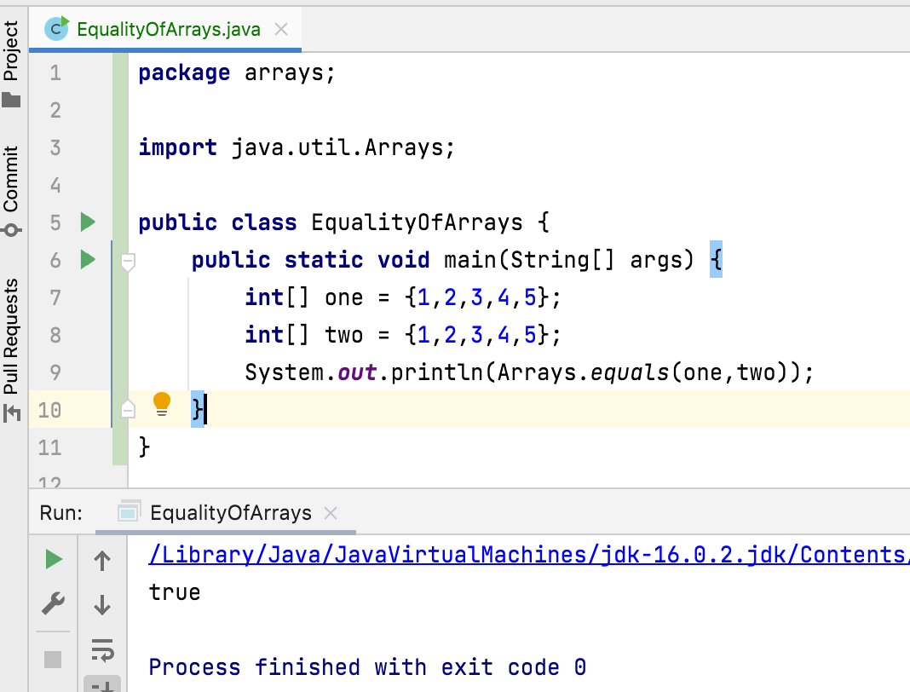

Slide 4
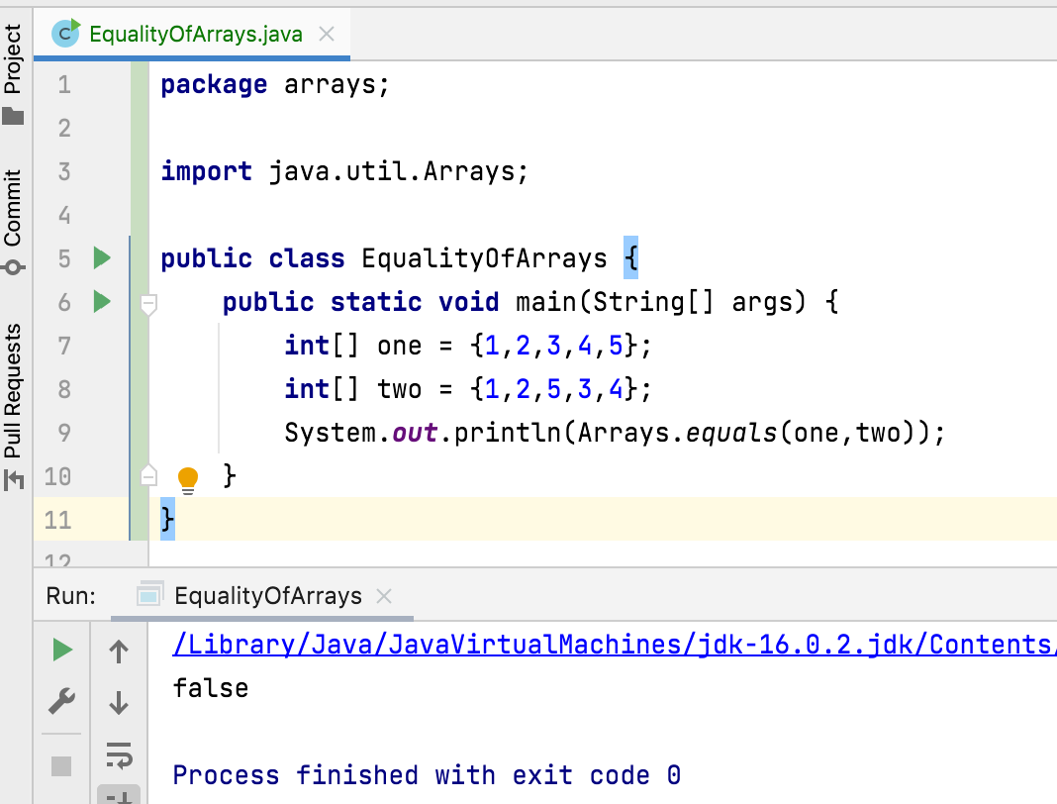
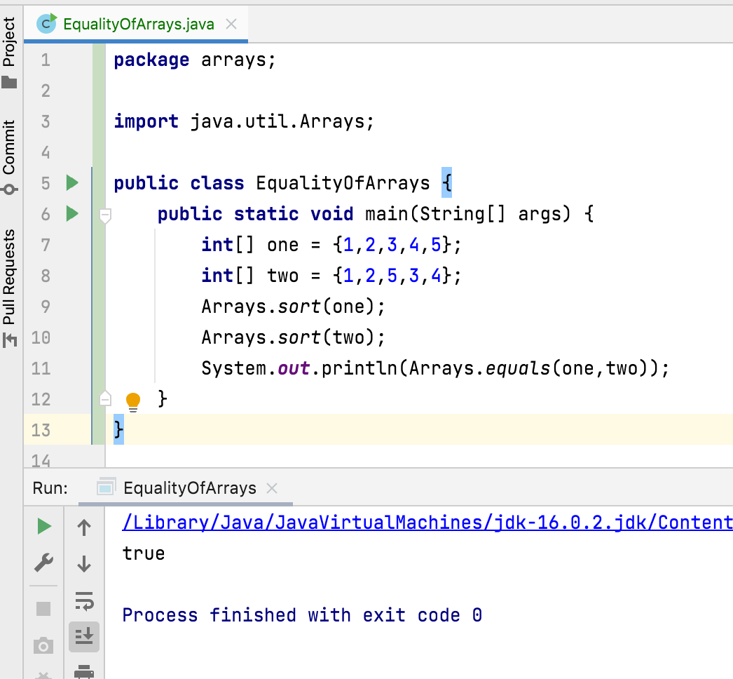

Slide 5
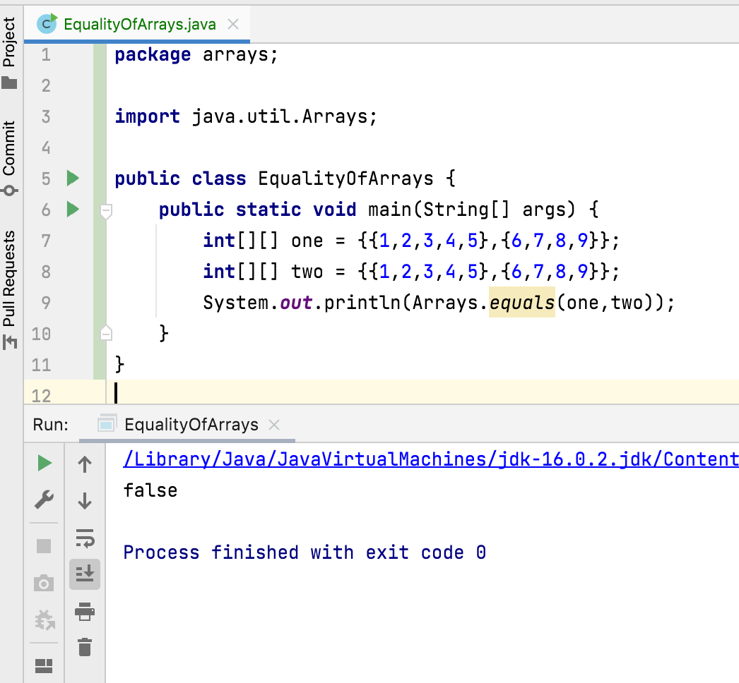
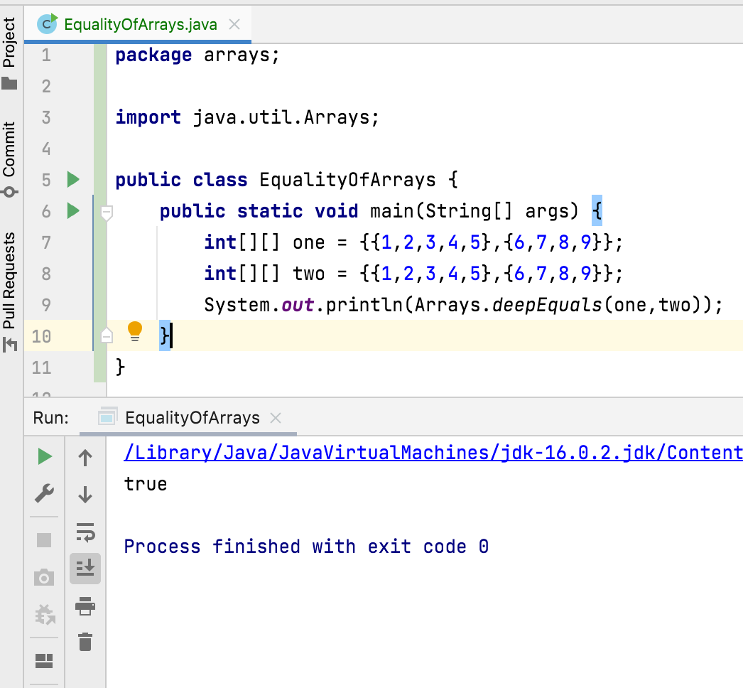

Slide 6
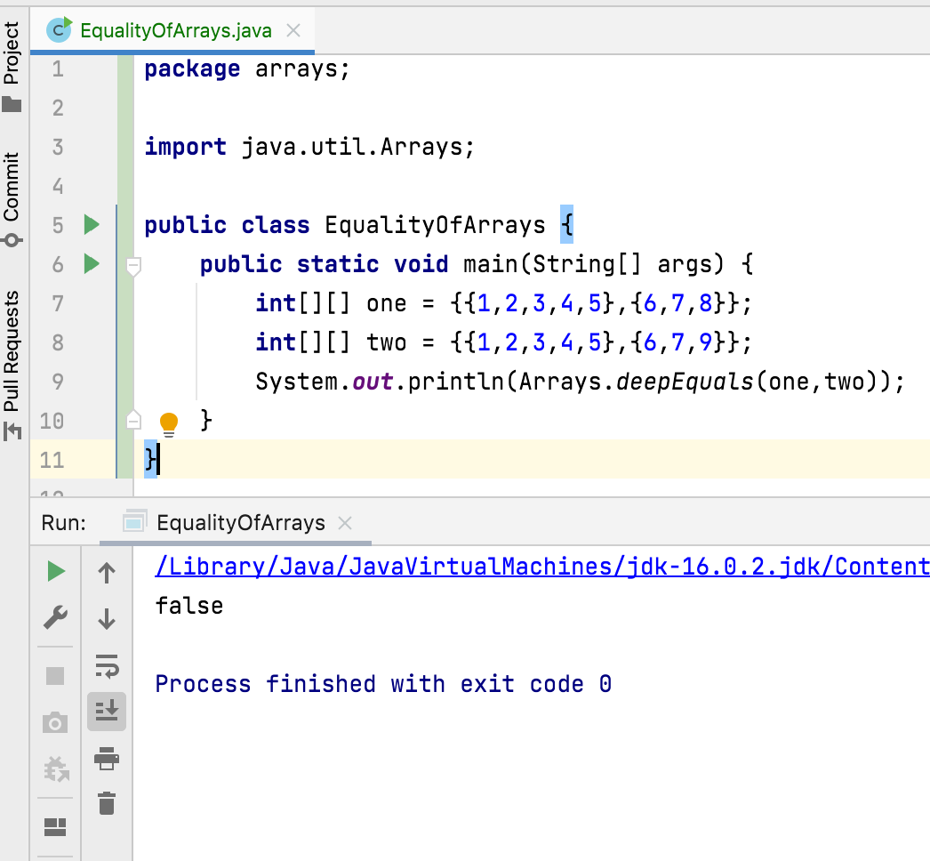
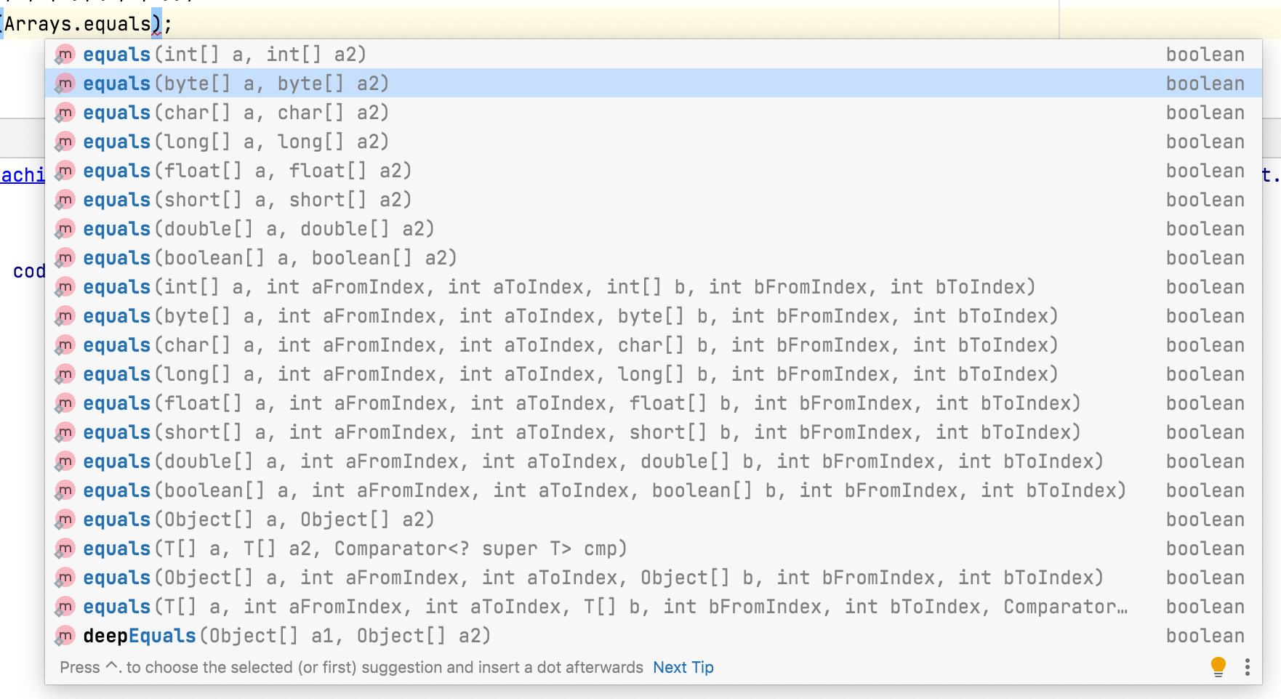

Slide 7
How to check the Equality of two arrays ?
Arrays.equals(array1, array2)
This method takes two arrays as parameters and returns true if both the arrays have same number of elements and corresponding pairs of elements of both arrays are equal.
If we want to compare two arrays which have same number of elements and same set of elements but in different positions, then first sort both arrays using Arrays.sort() method and then compare using Arrays.equals() method.
Arrays.deepEquals(array1, array2)
If we are checking multidimensional arrays for equality, then use deepEquals() method of Arrays class instead of equals() method. Because deepEquals() performs deep comparison of both the arrays.

Slide 8
Thank You !
momedaram

